Slide 1
Chemistry – Sept 26, 2019
Do Now – List three physical properties of gasoline and one chemical property.
Get out the PP/CP and PC/CC
Worksheet for Hmk check

Slide 2
Objectives and Agenda
Objectives
To plan to separate a sample of sand, salt, iron filings and poppies
Assignment: Prelab for Separation Lab
Agenda
Element Quiz
Homework Review
Separation Methods review
Separation Lab Prelab
Prelab hints
Report outline

Slide 3
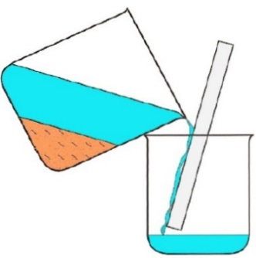
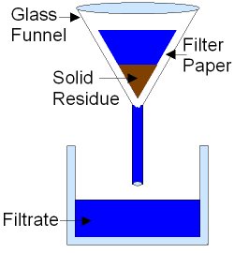
Mechanical Means of Separation
Decantation (separates a solid from a liquid or two liquids based on density)
Filtration (separates a solid from a liquid based on particle size)
Centrifugation (separates a solid from a liquid or two liquids based on density)
Distillation (separates two liquids based on boiling point)
Chromatography (separates any two substances based on affinity for a support substance)

Slide 4
Separation Lab Prelab
On Tuesday and Thursday we will do our second real lab with a modified lab report this time.
It is a separation mystery for you to solve. For the Prelab:
Prepare 1) A flowchart for your separation strategy
2) A procedure to accomplish this separation strategy (what will you do first, second….)
3) A data table to collect all necessary data for the needed calculations. (Or at least an area to collect data as you work.)

Slide 5
Separation Lab overview
Given a mixture of Sand, Salt, Poppy Seeds and Iron Filings, design and execute a separation method.
Write a proposed procedure to start. (Prelab – must be approved before you start)
When executing your procedure, record every action you take in the order you do them to create the real procedure that you used. No observation is too trivial. Keep track of where all 4 components are located at all times.
Separate, dry and weigh each of the four substances based on their properties.
Determine the percent composition of each of the four substances in the mixture.
Determine the percent recovery of matter from the mixture.

Slide 6
Prelab Hints
Before you do anything else, you will need to weigh the mass of the mixture you are given in a dixie cup. Later after you have removed the mixture from the cup you will want to measure the mass of the cup alone.
Iron is magnetic but none of the others are
Salt dissolves in water but none of the others do
In water, poppies float, but iron and sand sink
Don’t add water until you really want to, and use a limited amount, because you’ll just have to boil it away later.

Slide 7
Abbreviated Report Format
Shortened format (still 25 pts)– not all sections of the general report present.
Perform lab work in pairs or trios Share data with partner(s)
Each student writes their own report
Hand written is easiest for this report. But typed is acceptable.
Prelab (3) – Include your original flow chart, procedure and data table.
Procedure (5) – Include the notes you generated during lab and any measurements you made.
Data Table and Calculations (10) – five dry mass weights, four percent compositions, one percent recovery
Discussion questions (7) – from lab handout

Slide 8
Exit Slip - Homework
Exit Slip: (not done) What method would you use to separate an oil and water mixture? What physical property does this method exploit?
(Hint: There’s more than one correct answer.)
What’s Due? (Pending assignments to complete.)
Perform Separation Lab on Tuesday. Finish drying on Thursday.
What’s Next? (How to prepare for the next day)
Separation Lab

